Slide 1
Lending Club Case Study
SUBMISSION
Name: Barkha Saxena

Slide 2
Aim
To identify variables which are strong indicator of default for portfolio and risk management of finance company
A consumer finance company wants to mitigate the risk of loss on the loans being approved.
On receiving a loan application, there are 2 types of risk with the approval of loan:
Rejecting an eligible (likely to pay the loan back) candidate
Accepting an ineligible(defaulter) candidate.
As we have data for the approved loans , we will be working on the second risk mitigation.

Slide 3
Processing Flow
Data Cleaning
Treat missing values
Standardise values
Fix Invalid values
Filter data (remove on going
loans)
Univariate and Segmented Univariate Analysis
Bivariate analysis
Numerical columns
Correlation heatmap
Categorical columns
Treating ordinal (grade, emp_length)
Nominal values( purpose, verification_status,term, home_ownership)
Business
Understanding
( differentiating consumer attributes and loan attributes)
Decide target
variable
(a derived column
“is_defaulter”)
Understanding the distribution and values of column
Comparing distribution of each column for defaulters and not defaulters

Slide 4
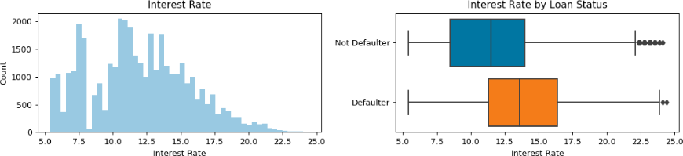
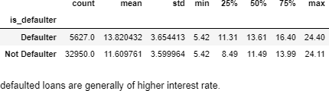
Higher the interest rate more tendency to default

Slide 5
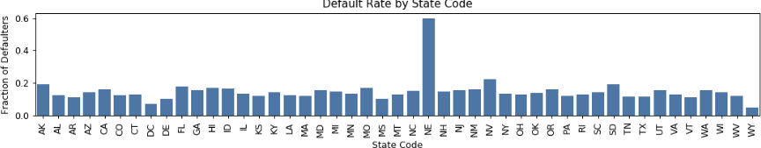
State of address : univariate analysis

Slide 6
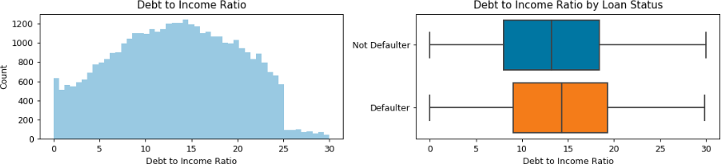
DTI directly affects default chances

Slide 7
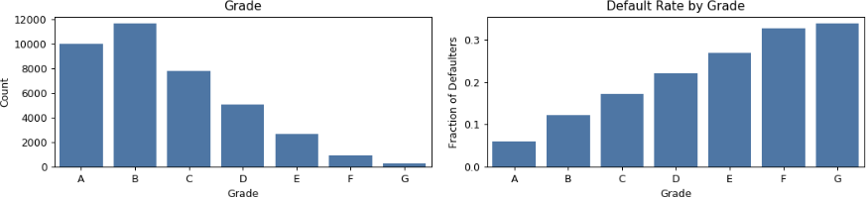
Grade’s tendency to default :univariate

Slide 8
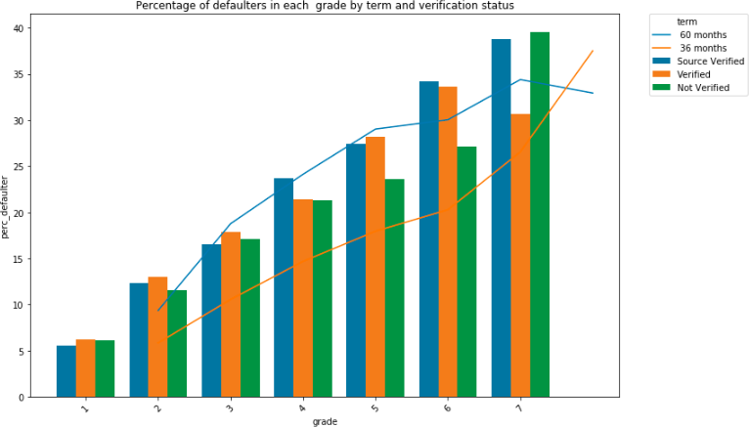
Grade’s tendency to default :bivariate
Key 1- A
B
C
D
E
F
G

Slide 9
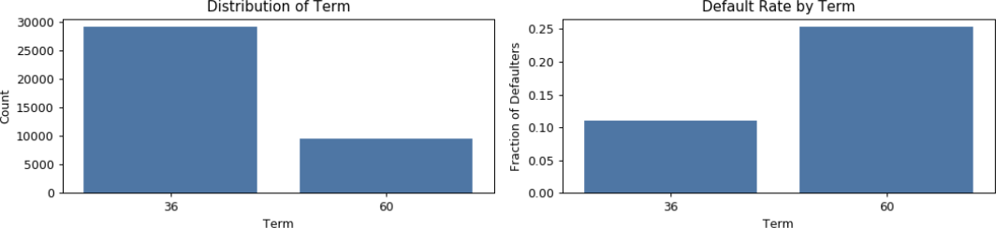
Term’s tendency to default
Plot 2
Term | Rate of Default
36 months | 11.09%
60 months | 25.31%

Slide 10
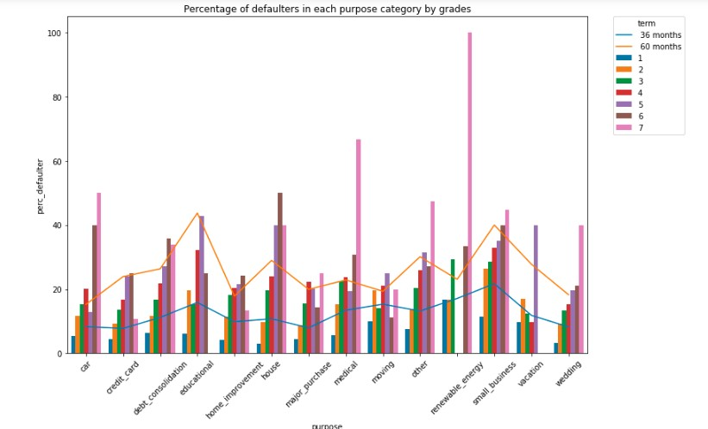

Percentage of defaulters in each purpose by grades and terms

Slide 11
Conclusion – indicator variables for default
Interest Rate (more the interest rate more chances of default)
Grade (generally going from A-> G risk of default increases but it has some exceptions)
Term (60 months term is more likely to default as compared to 36 months)
Purpose (small business is more likely to default as compared to any other purpose)
DTI (Debt to income ratio - more for defaulters)
Verification status

